Slide 1
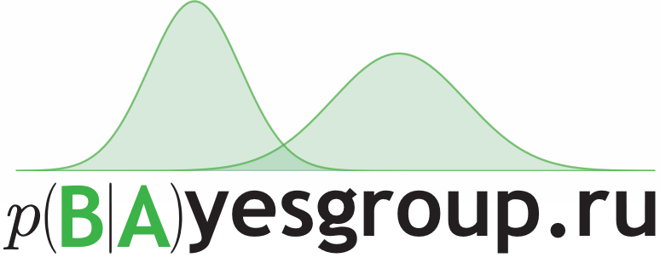

Deep Learning Software
Arsenii Ashukha
Aug 17th, 2017

Slide 2
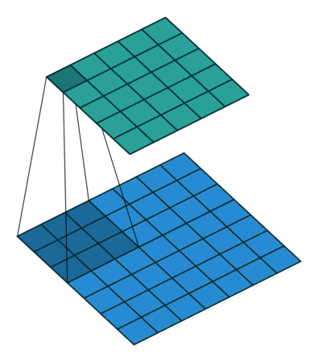
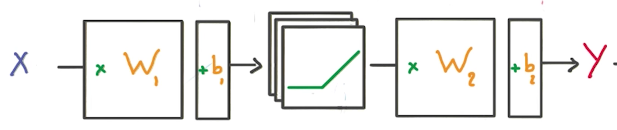
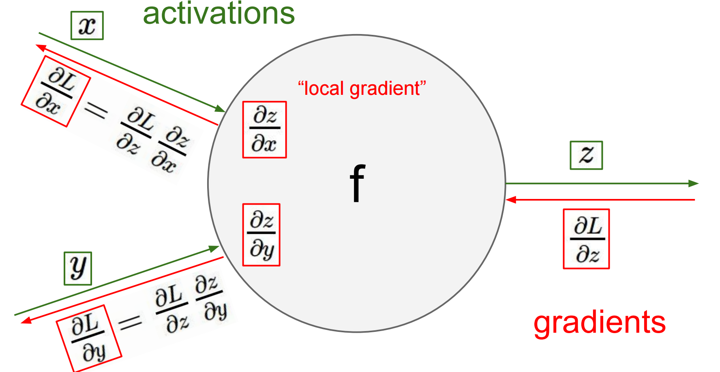
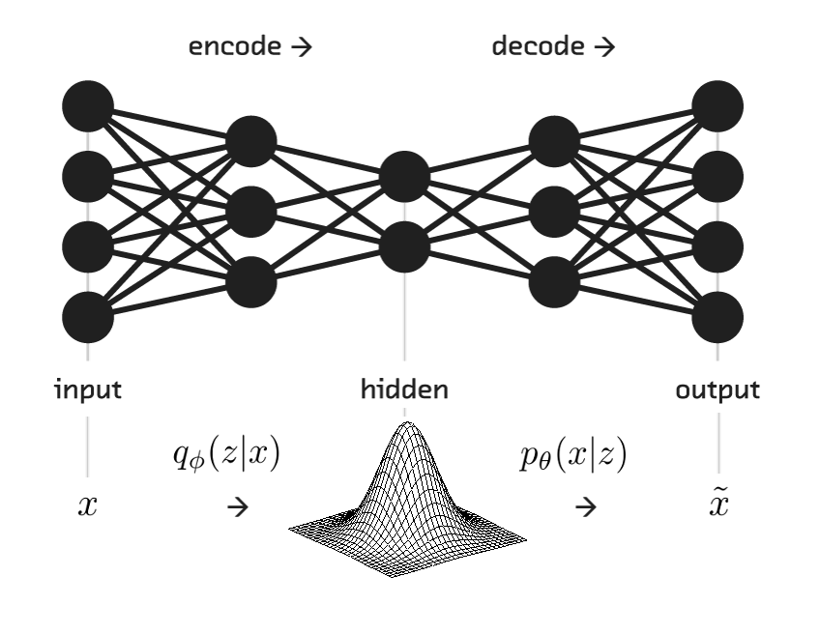

Earlier

Slide 3
The point of deep learning frameworks
Easily build big computational graphs
Easily compute gradients in computational graphs
Run it all efficiently on GPU (wrap cuDNN, cuBLAS, etc)
All frameworks do the same thing
but in different ways!

Slide 4
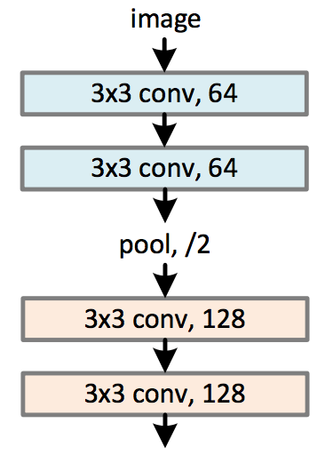
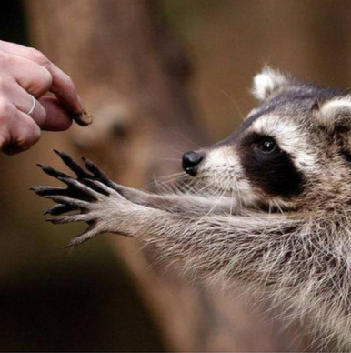
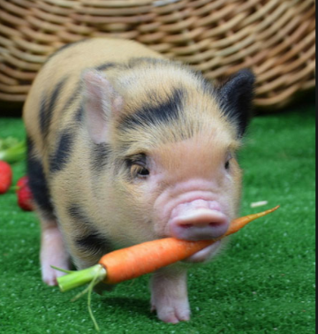

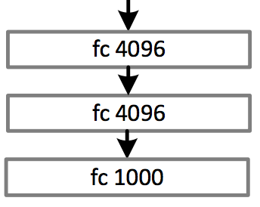
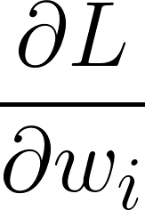
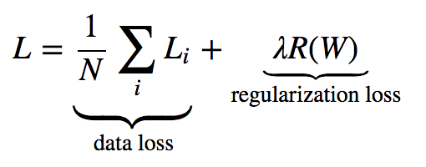
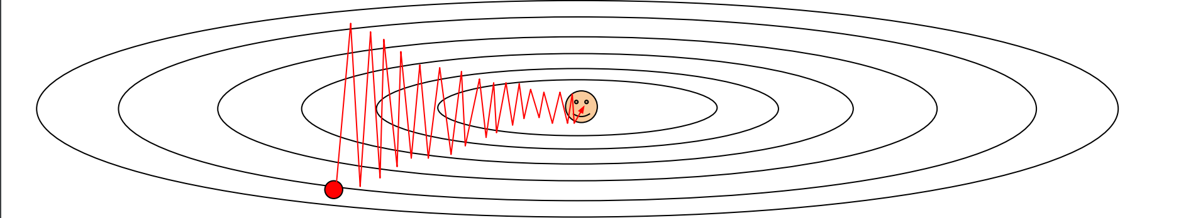
Standard Pipeline to Train your DNN
Before training:
Get your training/validation data
Define the model
A lot of times:
Sample a batch (subset) of images/labels
Evaluate the Gradient of the Loss function
Update the parameters using the Gradient

Slide 5
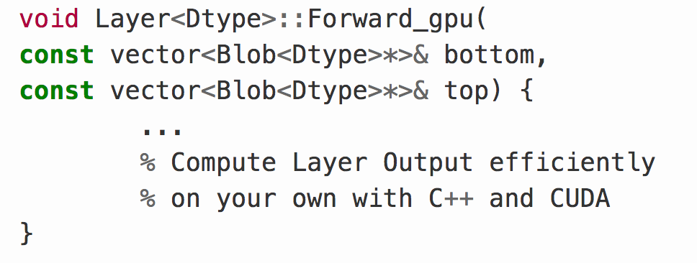

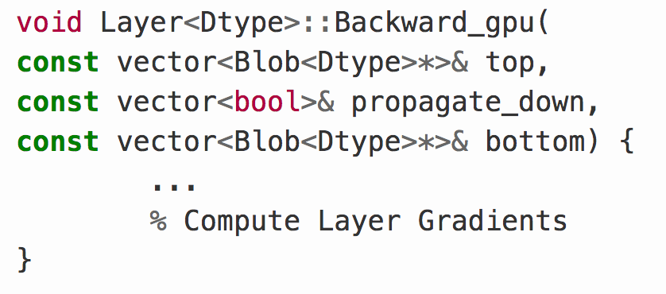

What is the simplest way to create a DL Library?
Layer
- You have to write C++ code if you want to define a new layer
Standard models with no coding at all
A lot of computer vision things are made with Caffe

Slide 6
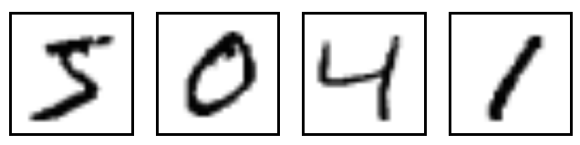
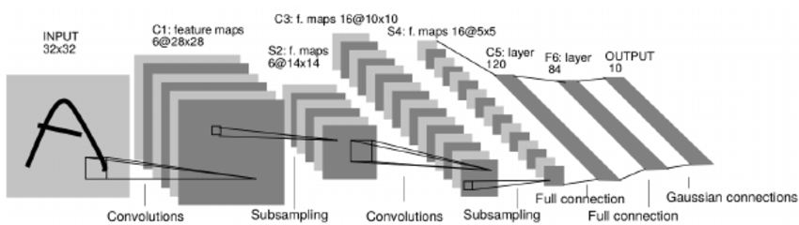
Caffe Example
name: "LeNet"
layer {
name: "conv1"
type: "Convolution"
bottom: "data"
top: "conv1"
param {lr_mult: 1}
param {lr_mult: 2}
convolution_param {
num_output: 20
kernel_size: 5
stride: 1
weight_filler {
type: "xavier"
}}}
….
130 lines

Slide 7
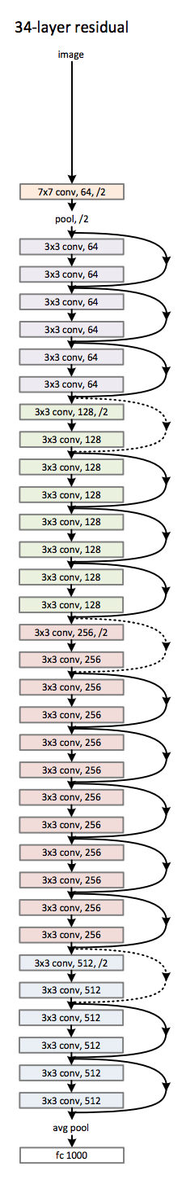

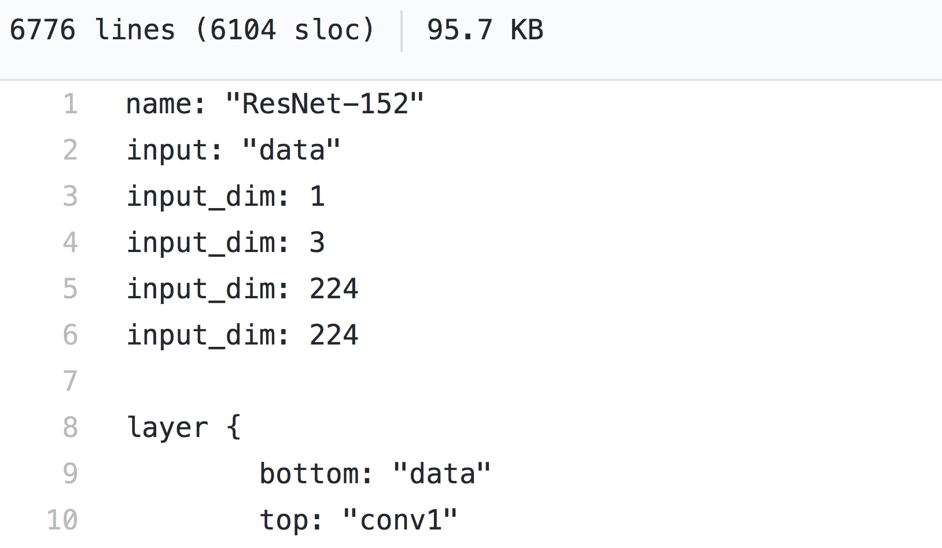
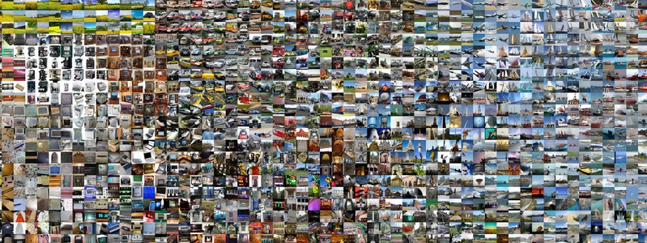
Caffe Example
6776 lines

Slide 8
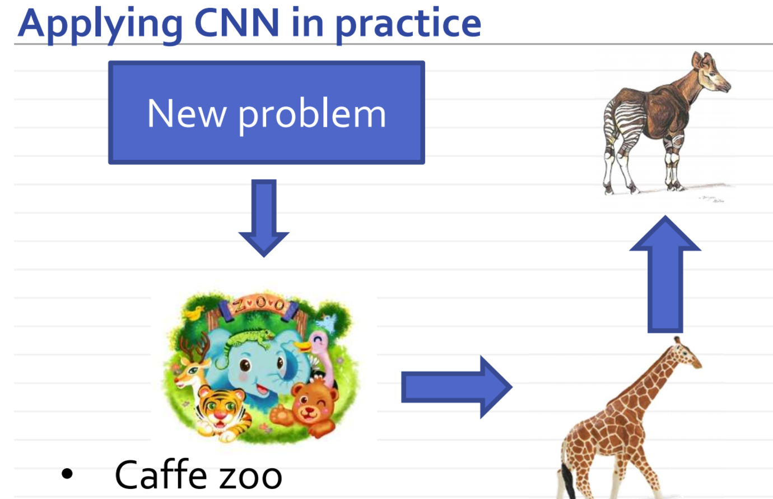
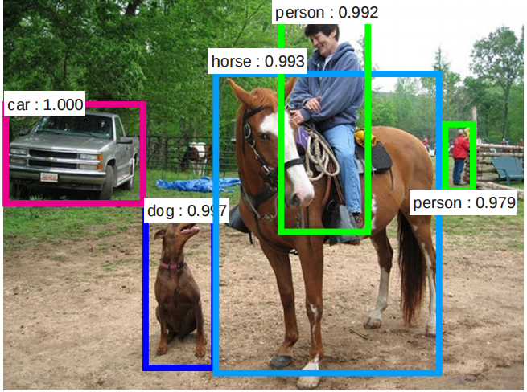
Caffe
Protobuf language
Hard to create your own layers (С++, CUDA, Recompile, ...)
Hard to debug
Easy to deploy, you can convert caffe models to pure C++
De facto standard in Computer Vision tasks
Rich Model Zoo
https://github.com/BVLC/caffe/wiki/Model-Zoo

Slide 9
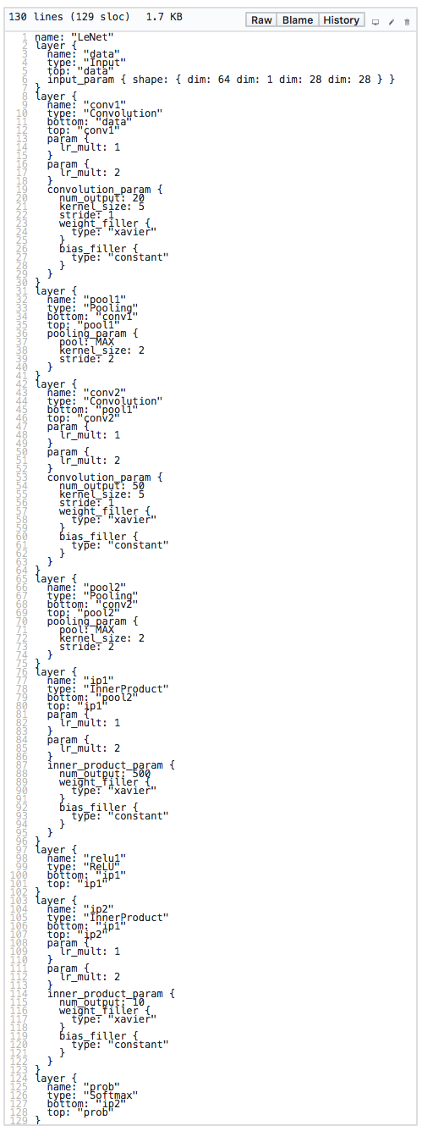
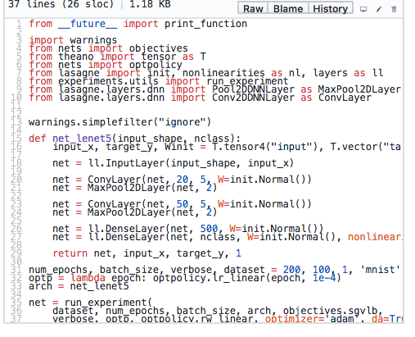
Lenet Caffe vs Theano
Caffe
Theano
130 lines
37 lines

Slide 10
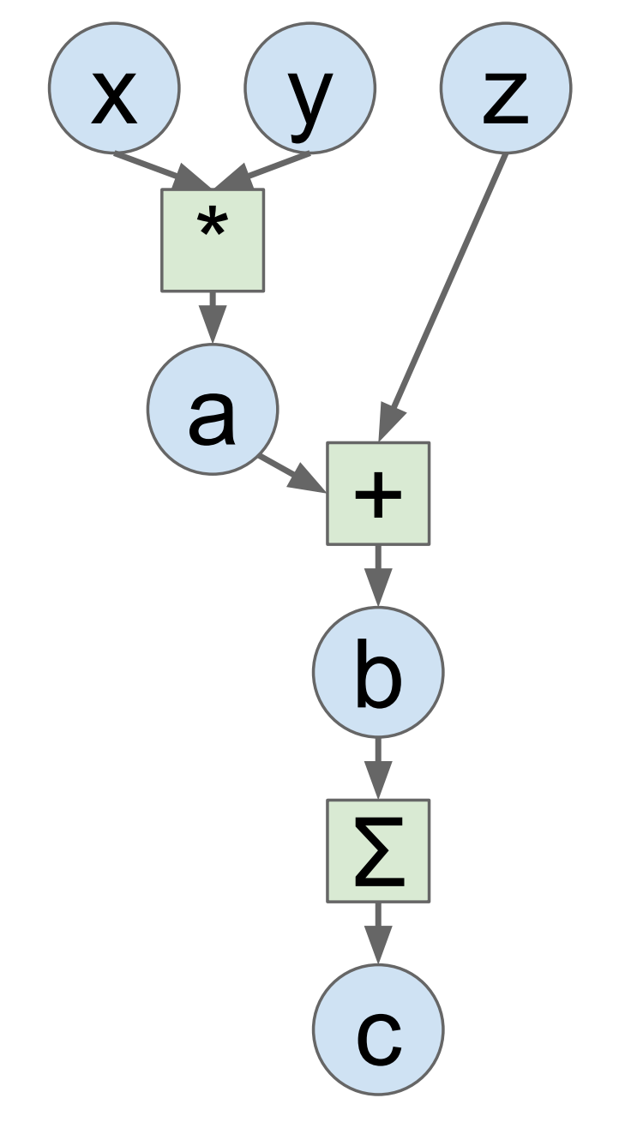
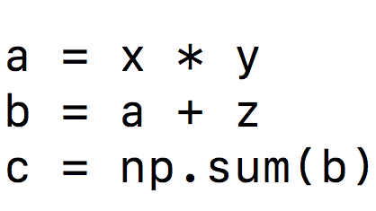


Static Computational Graph
+ Easy to build nets and eval gradients
+ We can optimize the Graph
- Graph is static during training
- Need time to compile/optimize
- Hard to debug
and

Slide 11


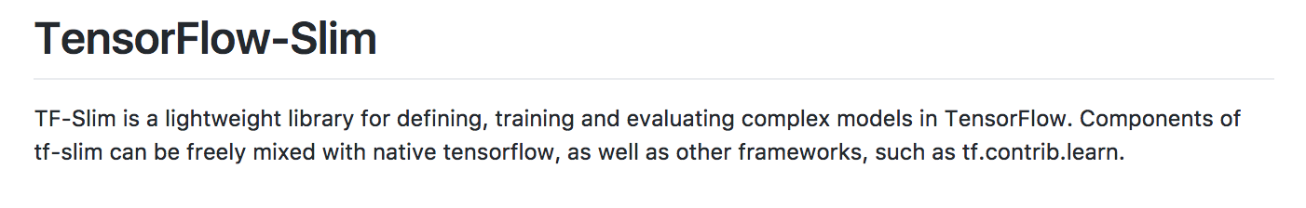
Wrappers
From basic operation sum, mul, log to layers!

Slide 12
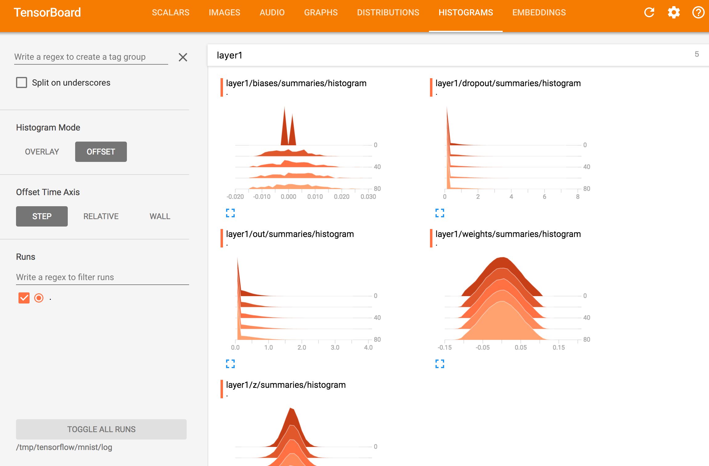
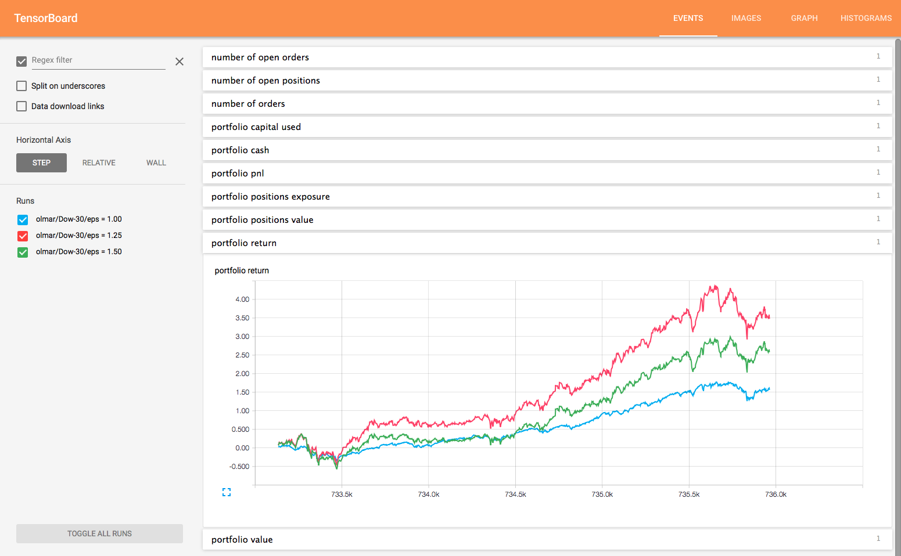
Tensor Board
Embeddings Visualization
projector.tensorflow.org

Slide 13
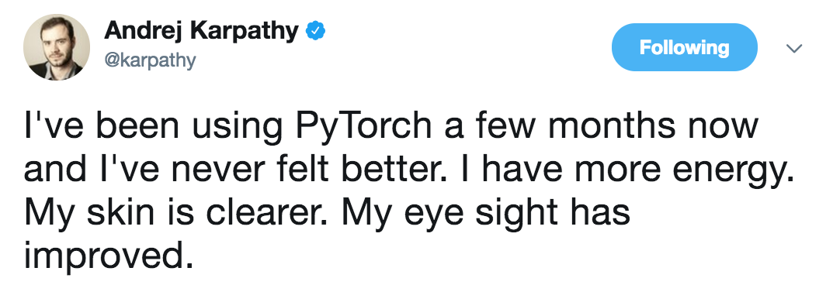
PyTorch

Slide 14

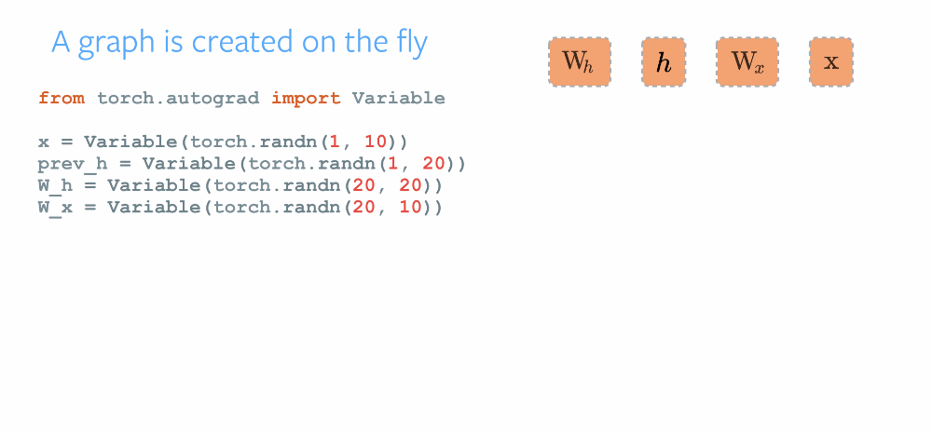
Dynamic Computational Graph
- Dynamic graph is hard to optimize
- Very young and still a bit raw
+ Step-by-step debugging
+ Changing architecture on the fly

Slide 15
How did we get over the head
We were happy with theano
Until we started working on ImageNet
We were happy with pytorch
Until we started working with Numerical Unusable code
Still trying to work with TF

Slide 16
Comparison
Paradigm | Declarative | Declarative | Declarative | Imperative
Language | Protobuf, C++ | Python, C | Python, C++ | Python, C++
Deployment | Easy to deploy |  | Easy to deploy
Model size |  | Good for small models | Good for large models | Good for large models
CV inside | Good for CV |  | Good for CV
Stability |  | Yes | Not yet | Not yet

Slide 17
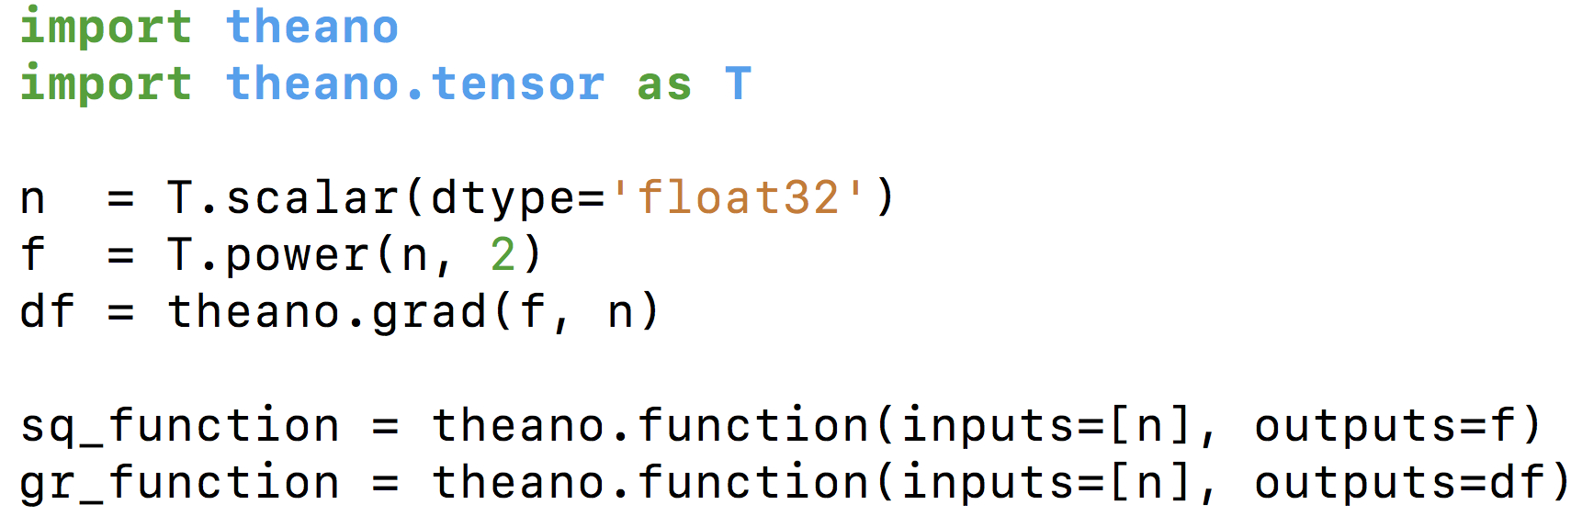
Theano
Imports
Create scalar node
Create operation @power for n and constant node
Create an expression df / dn
Compile graphs: input, result -> computable function

Slide 18
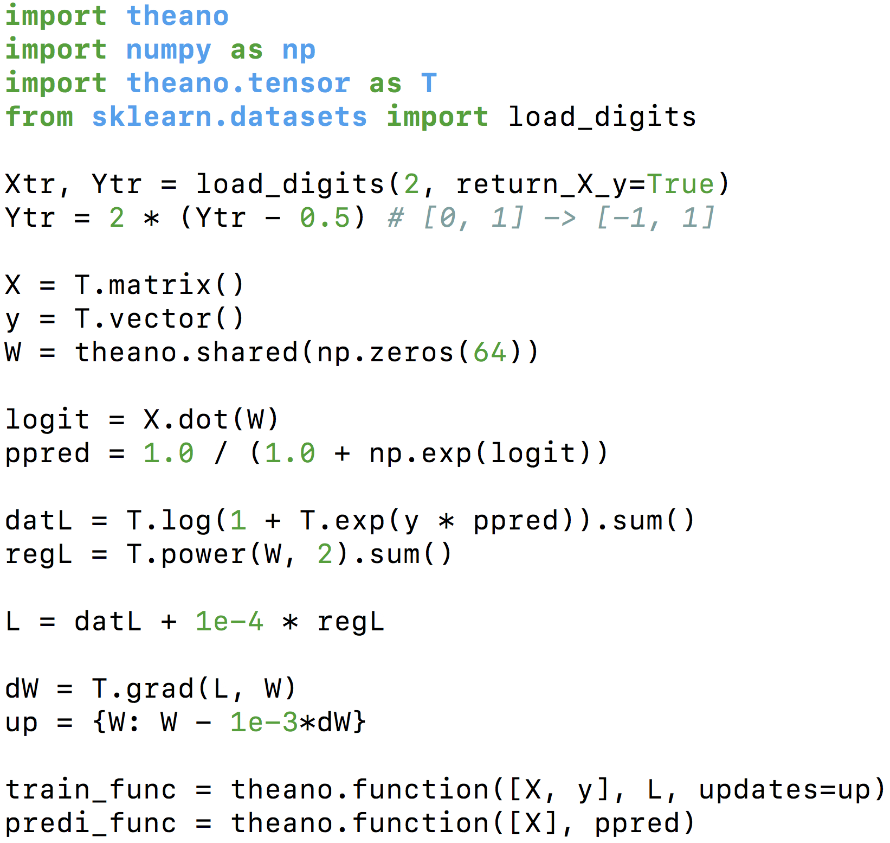
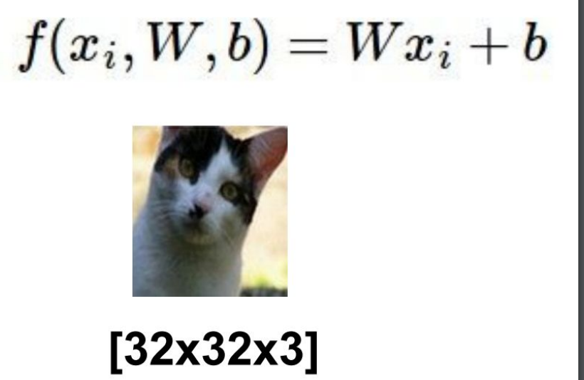
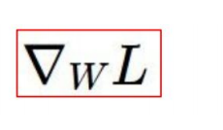
Log Reg Theano

Slide 19
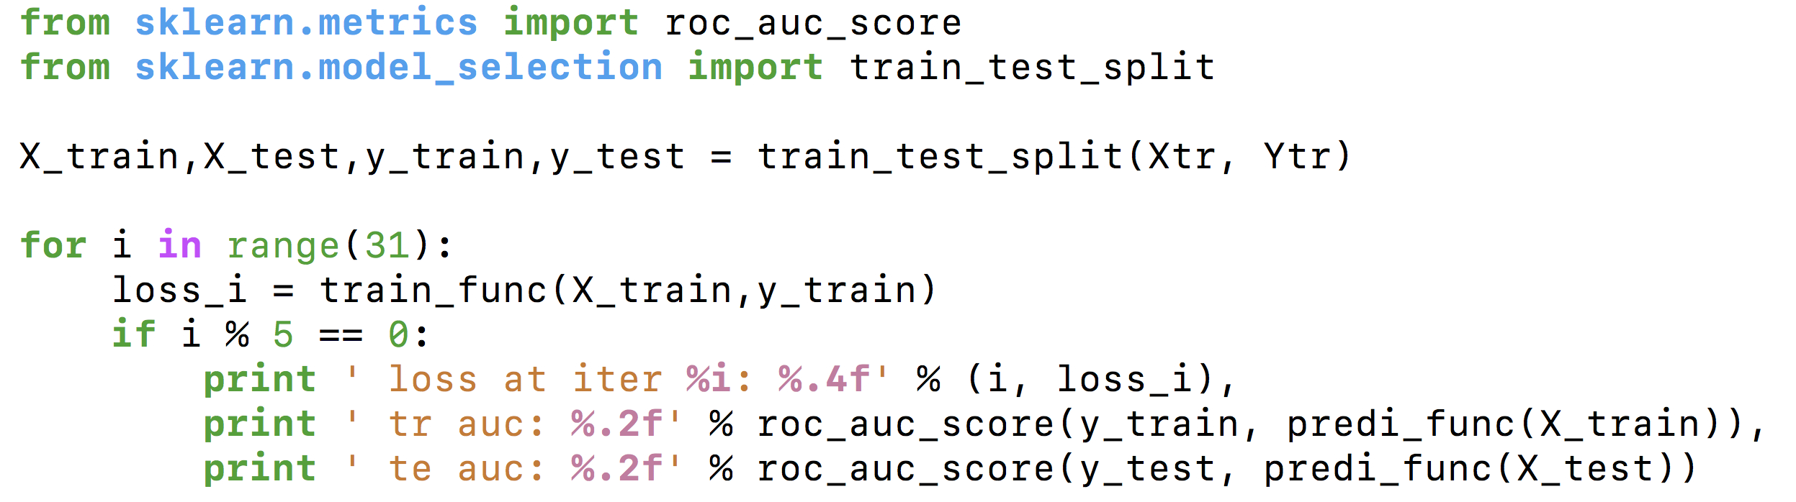

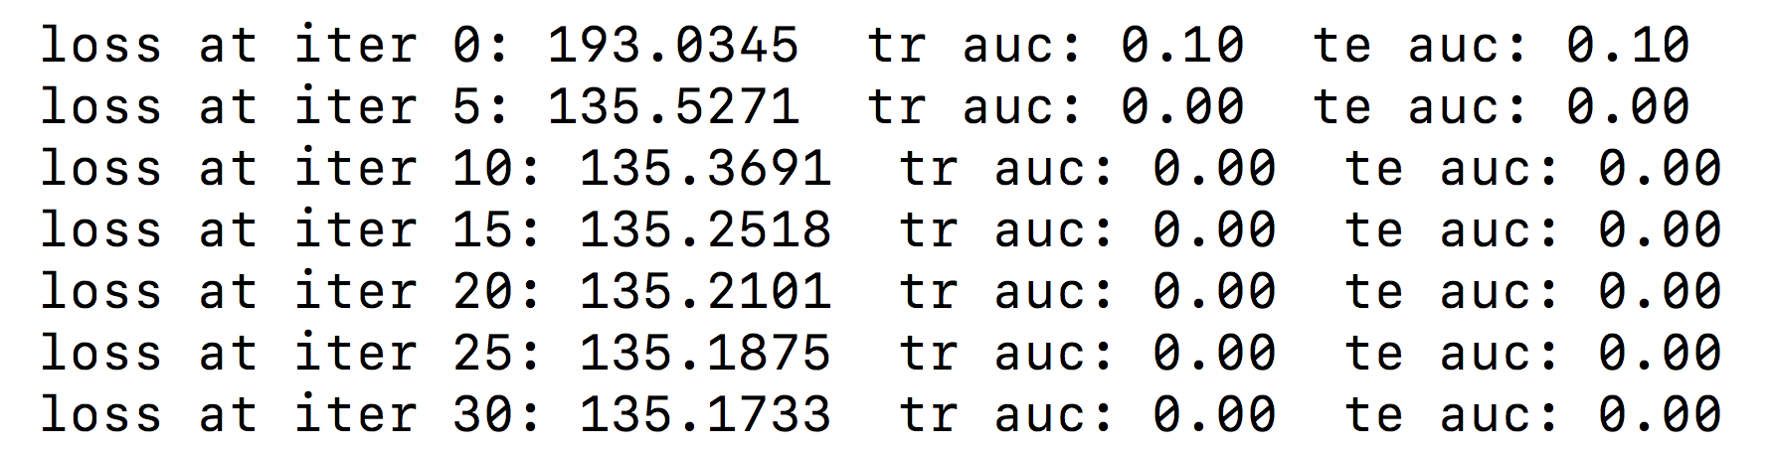
Log Reg Theano
What goes wrong?

Slide 20
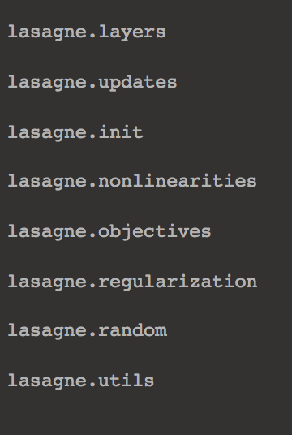
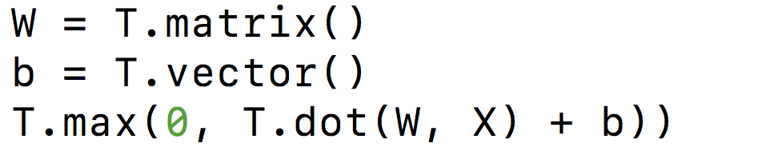

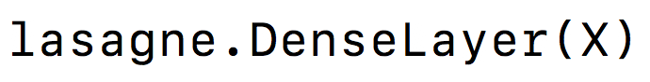
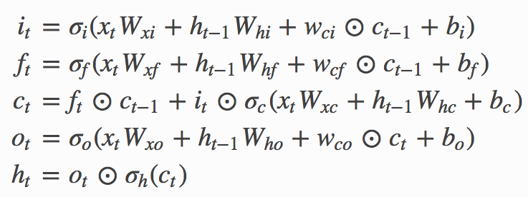
Lasagne

Slide 21
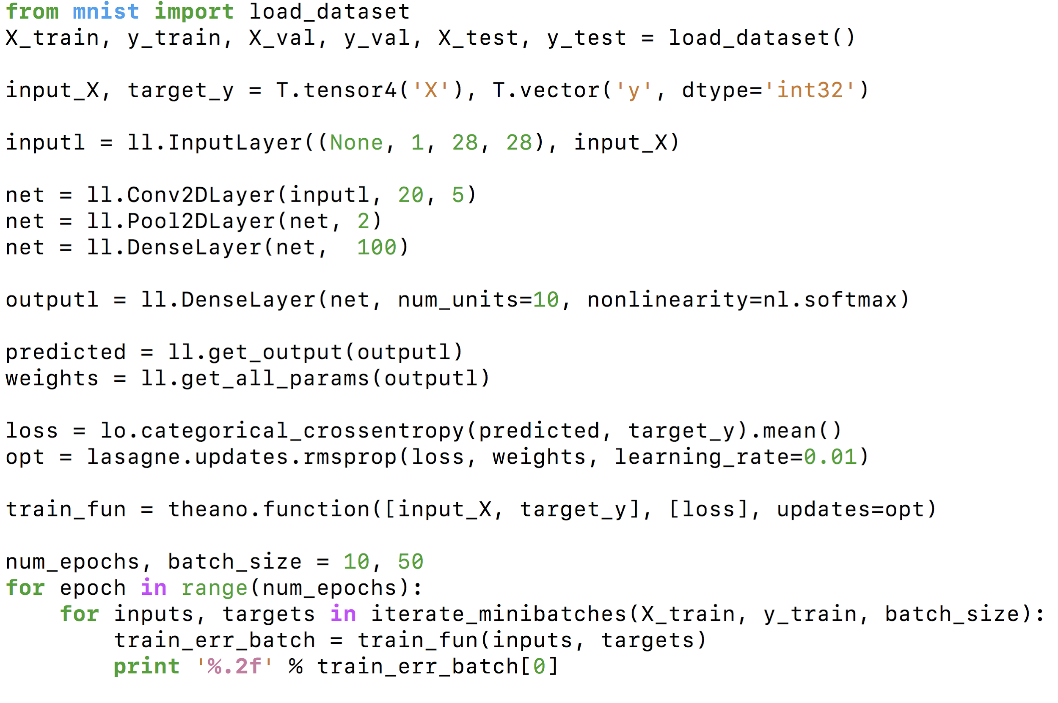
Lasagne: Simplest Network
Read Dataset
Create X, y variables
Define your DNN
Define loss and opt
Compile the Graph
Iterate over batches

Slide 22
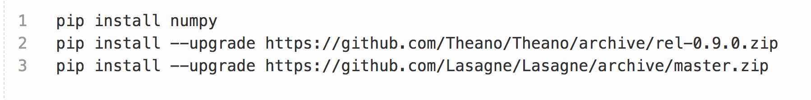
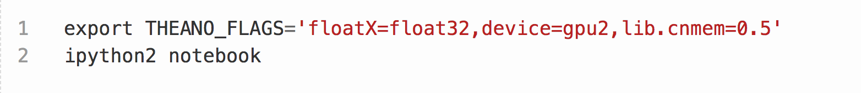
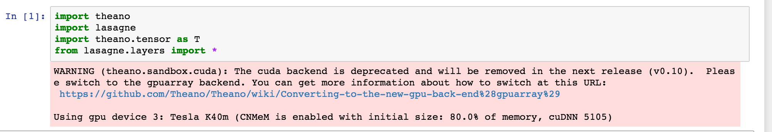
Theano Install and Run

Slide 23
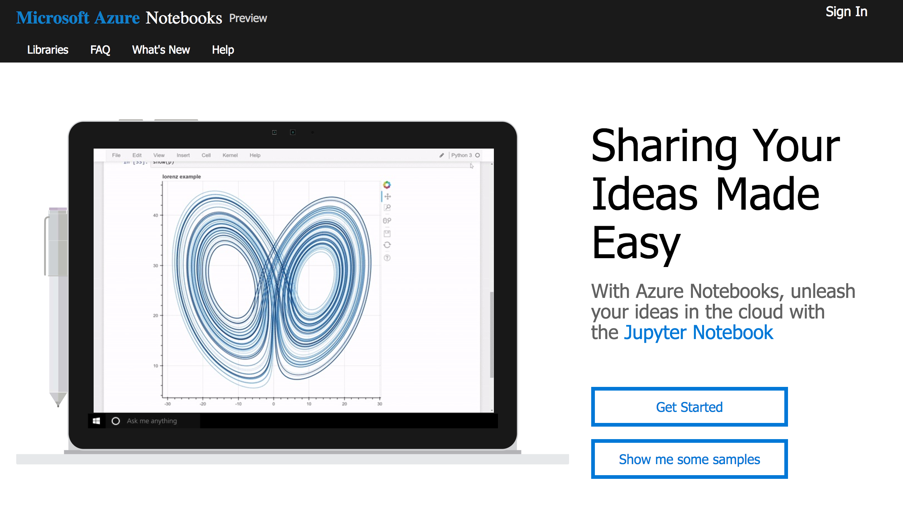
Azure Notebooks
https://notebooks.azure.com

Slide 24
Summary
All frameworks do the same thing but in different ways!
Good idea is to choose framework for your requirements
Caffe seems good only if you are in Computer Vision
TF or PyTorch are good default choice, but they still have a couple of troubles (optimization, rawness, ...)
Theano is good only for small nets and easy prototyping with a power graph optimization inside

